Slide 1
Analysis and identification of malicious mobile applications
CSE7101- Capstone Project
Review-1
Batch Number: COM_14
Under the Supervision of,
Dr./Mr./Ms./Prof. Mr. Asif Ahmad Najar
Professor / Associate Professor / Assistant Professor
School of Computer Science and Engineering
Presidency University
Student Name | Roll Number
AMISHA | 20221COM0170
PRIYANKA | 20221COM0219
SHREYAS B R | 20221COM0191
Name of the Program: Computer Engineering
Name of the HoD: Dr.PALLAVI R
Name of the Program Project Coordinator: Mr.Muthuraju V
Name of the School Project Coordinators: Dr. Sampath A K , Dr. Geetha A

Slide 2
Problem Statement Number: pscs_68
Organization: Presidency University
Category : Software
Problem Description: - Analysis and identification of malicious mobile application With the rapid growth of smartphones and mobile applications, users install multiple apps for various daily tasks such as communication, shopping, banking and entertainment . However, many applications may contain hidden malicious code that can steal sensitive information, monitor user activity or misuse system resources.

Slide 3
Abstract:
The rapid growth of mobile applications has significantly increased the risk of malicious software targeting smartphones. This paper presents a comprehensive study on the analysis and identification of malicious mobile applications. It examines various categories of mobile threats, including malware, adware, spyware, and phishing applications, and discusses existing analysis methodologies. To address the limitations of traditional approaches, the paper proposes a hybrid detection methodology that integrates static analysis (examining code structure, permissions, and malware signatures) with dynamic analysis (observing application behavior at runtime in sandbox environments). This combined approach enhances the accuracy and efficiency of detection, enabling both the identification of known malware families and the recognition of novel, previously unseen threats.

Slide 4
Objectives:
To analyze mobile apps using static and dynamic techniques for better threat detection.
To detect both known malware families and new/zero-day threats.
To evaluate performance with precision, recall, and F1-score.
To enable real-world use in app stores, antivirus tools, and MDM solutions.

Slide 5
Methodology:
Data collection and Preprocessing
Official app marketplaces
Third party repositories
Controlled malware datasets
Preprocessing: Extract metadata (app name, version, permissions, manifest details). Detect obfuscation/packing and record it for further inspection.

Slide 6
2. Static Analysis
Performed without executing the app, focusing on its structure and permissions:
Permission Analysis – Evaluate requested permissions for potential misuse.
Code Review – Inspect code for suspicious function calls or malware signatures.
Signature-based Detection – Compare apps with known malware signature databases.
3. Dynamic Analysis
Apps were executed in a sandbox environment to observe runtime behavior:
Behavior Monitoring – Track system calls, network requests, and resource usage.
API Call Tracing – Identify suspicious interactions with device functionalities.
Sandbox Isolation – Ensure safe execution without affecting the host device.

Slide 7
4. Machine Learning Integration
Features from both static and dynamic analysis were combined for classification:
Feature Extraction – Gathered permissions, API calls, system events, and anomalies.
Model Training – Supervised learning models (Random Forest, SVM) trained on labeled benign and malicious apps.
Classification – Predict whether an app is benign or malicious.

Slide 8
Existing Methods and Drawbacks :
Signature-Based Detection
Method: Matches apps with known malware signatures.
Drawback: Ineffective against zero-day malware and obfuscated code; needs constant signature updates.
2. Static Analysis
Method: Examines app code, permissions, and resources without execution.
Drawback: Cannot detect runtime behaviors; vulnerable to obfuscation and dynamic code loading.

Slide 9
3. Dynamic Analysis
Method: Runs apps in a sandbox to observe runtime behavior (API calls, network traffic, system calls).
Drawback: Slow, resource-intensive, and may be evaded by sandbox-aware malware; might miss hidden triggers.
4. Machine Learning Approaches
Method: Uses features (permissions, API calls, behavior) to classify apps as benign or malicious.
Drawback: Highly dataset-dependent; risk of false positives; deep learning is computationally costly and less interpretable.

Slide 10
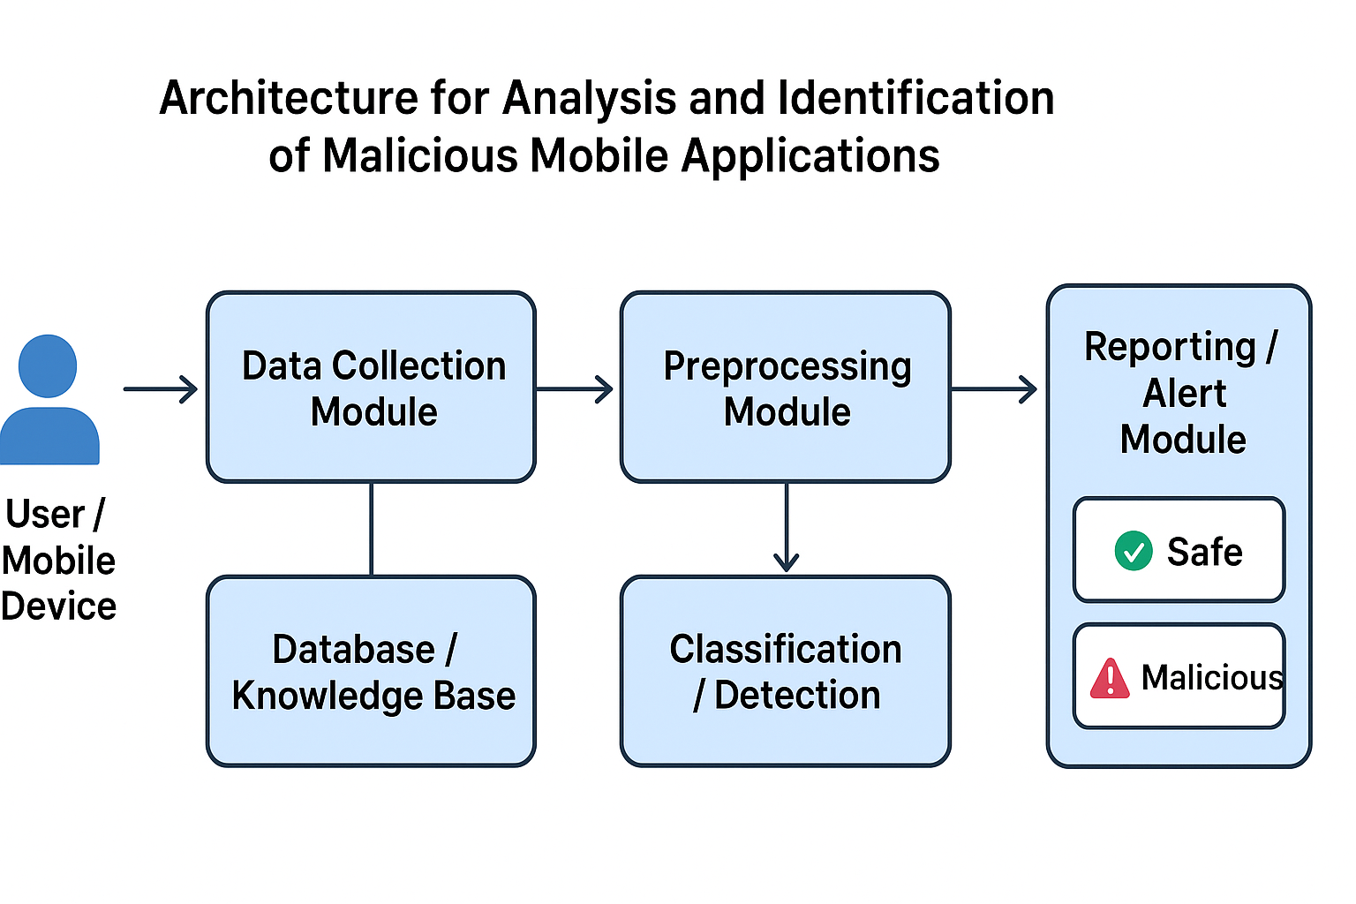
Architecture diagram :

Slide 11
Software details & Technologies used:
Frontend (User Interface)
A simple UI where user uploads an APK → system shows. ✅ Tools:
React.js (modern, easy to integrate)
Angular (if you already know it, since you mentioned earlier)
TailwindCSS or Bootstrap (for styling)
Backend (Server + API)
Run the analysis + ML model on uploaded APK
Python (Flask / FastAPI) → Best for quick ML integration
Node.js (Express) → If you prefer JS backend

Slide 12
Database (Optional – if storing results/history)
Store scanned APK results, user history, ML logs. ✅ Options:
MongoDB (NoSQL, works well with Node.js)
MySQL/PostgreSQL (if you want relational DB)
Machine Learning Classifier
Train a model using features from static/dynamic analysis. ✅ Tools/Languages:
Python (main language for ML)
Scikit-learn (Random Forest, SVM)
Pandas, NumPy (data preprocessing)
Matplotlib/Seaborn (graphs, confusion matrix)
TensorFlow/Keras (deep learning model)

Slide 13
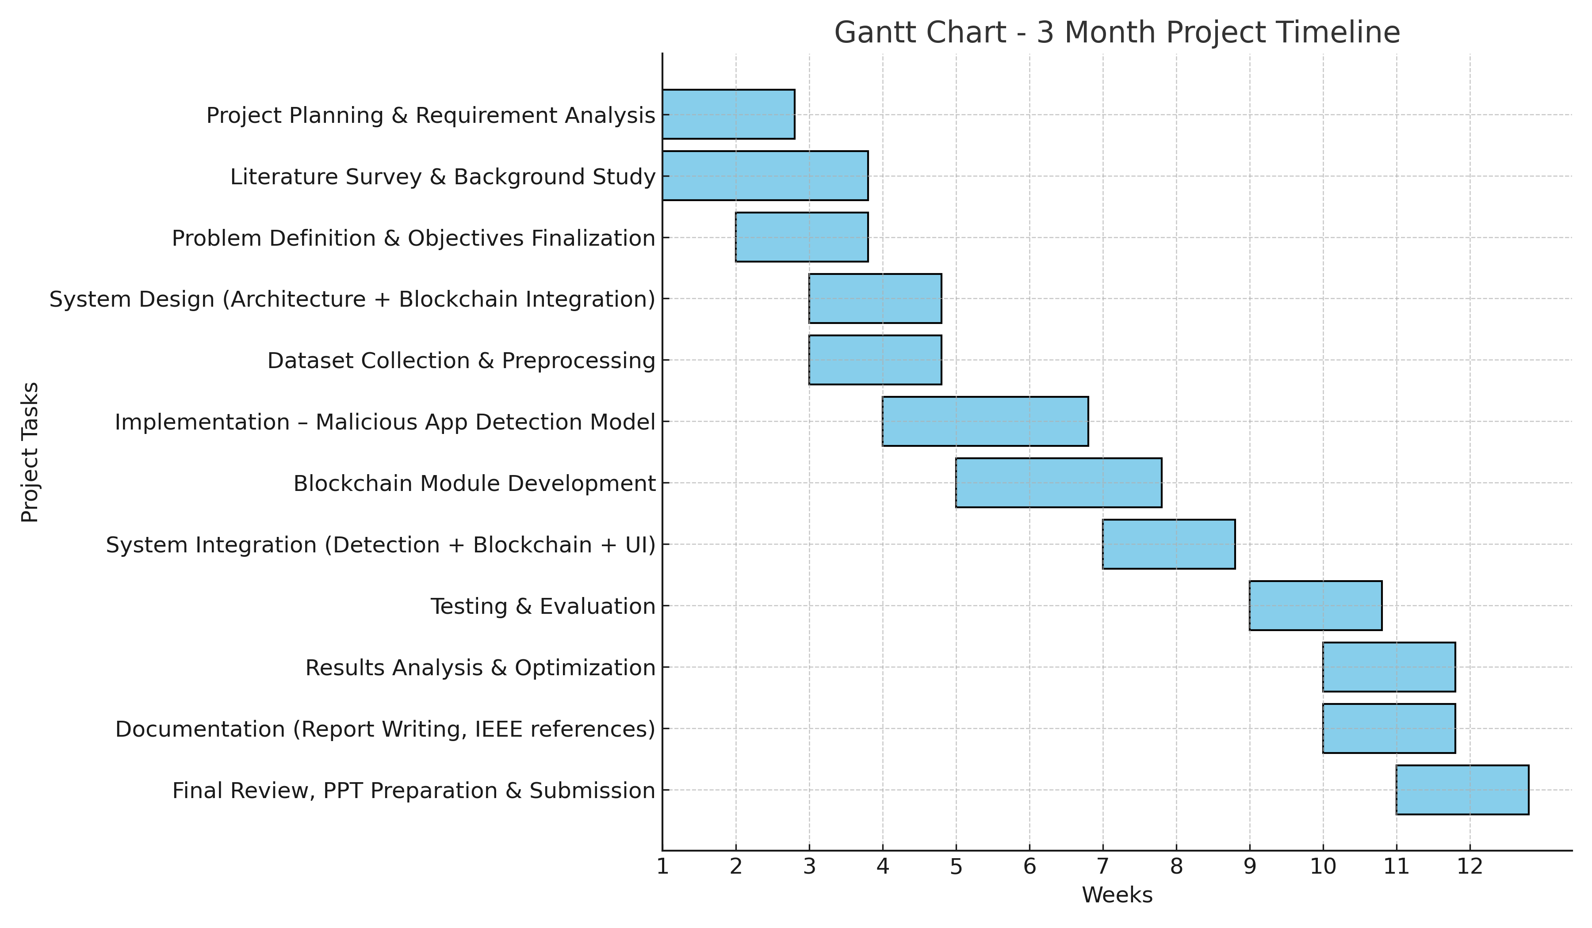
Timeline of the Project (Gantt Chart)

Slide 14
References (IEEE Paper format)
1. Wu, D., Mao, Y., Wei, T., & Wang, D. ( 2016 ). Dexiot: A Novel Framework for Android Application Opcode Sequence Analysis. IEEE Transactions on Information Forensics and Security, 11 ( 4 ), 739–752.
2. Y. Zhao, Z. Li, and H. Liu, “An Android Malware Detection Method Using Frequent Graph Convolutional Neural Networks,” Electronics, vol. 14, no. 6, p. 1151, 2025, doi: 10.3390/electronics14061151.
3. F. Güneş, “Hybrid Multilevel Detection of Mobile Devices Malware Under Concept Drift,” J. Netw. Syst. Manag., vol. 33, art. 56, 2025, doi: 10.1007/s10922-025-09906-3.

Slide 15


